Slide 1

ISTA 350
Car sales plot
Presented by :
Bolor-Erdene Altanmunkh

Slide 2
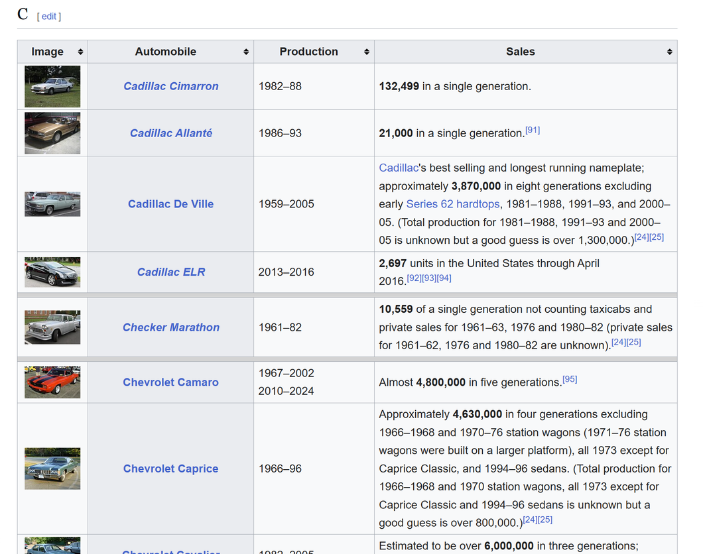
First look at the website
The dataset for this project is collected from Wikipedia by scraping structured tables related to automobile sales. The primary source is a list of automobile sales by model page, which provides information such as car model names, manufacturers, production periods, and total units sold.
Uniqueness of the webpage
Split into multiple tables
Organized by manufacturer
The “Sales” column is not standardized
Production years are not uniform
Wikipedia page link

Slide 3
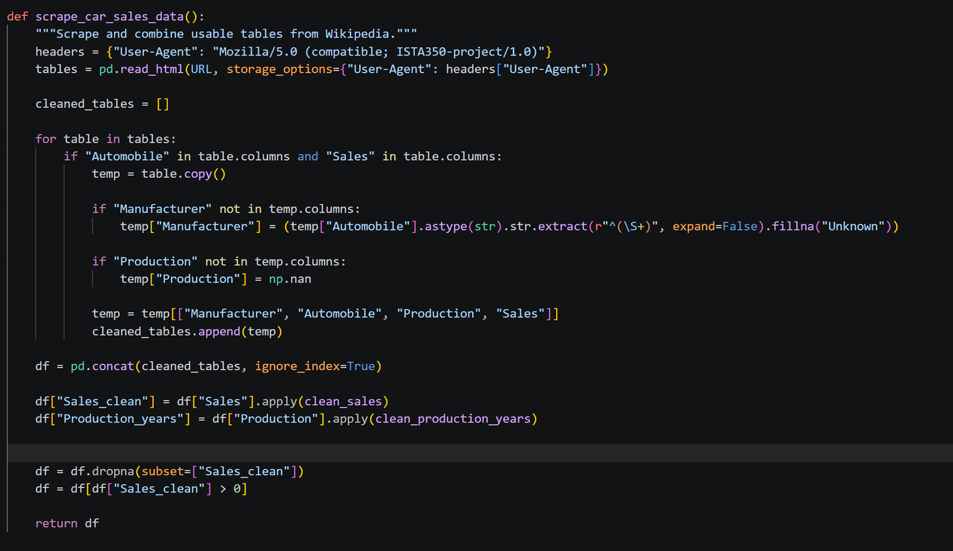
Scrapping
Scrapes multiple tables from Wikipedia
Filters relevant tables with “Automobile” and “Sales”
Handles missing columns such as Manufacturer and Production
Standardizes table structure
Combines tables into one dataset
Cleans data using custom functions
Removes missing values
Notes:
This function is responsible for scraping and preparing the dataset from Wikipedia for analysis.
I use pandas’ read_html() function to extract all tables from the webpage. Since the data is split across multiple tables, this returns a list.
Not all tables are relevant, so I filter only those that contain both ‘Automobile’ and ‘Sales’ columns.
Some tables don’t include the manufacturer or production columns. I handle this by either extracting the manufacturer from the car name or assigning missing values.
To make all tables consistent, I selected only four columns: Manufacturer, Automobile, Production, and Sales.
Since the data is spread across multiple tables, I merge them into a single DataFrame using concatenation.
I apply custom cleaning functions to convert messy text into numeric values, such as extracting total sales and calculating production duration
Finally, I remove rows with missing or invalid sales values to ensure accurate analysis.

Slide 4
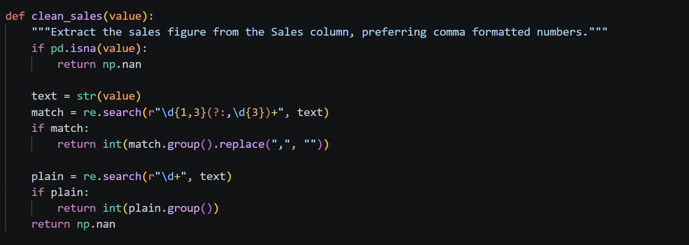
Clean sales function
Extracts numeric sales values from messy text
Handles missing values
Uses regex to find formatted numbers such as 1,000,000
Falls back to simpler number extraction
Converts output into integer format
Notes:
This function is responsible for cleaning the sales data, which is messy because it comes from Wikipedia.
First, it checks if the value is missing. If it is, it returns NaN so we don’t process invalid data
Then I convert the value into a string so I can apply text processing using regular expressions
Next, I use a regular expression to extract numbers with commas, like one million written as 1,000,000. This is the preferred format because it represents full values.
If a match is found, I remove commas and convert the value into an integer so it can be used for analysis
If no formatted number is found, I use a simpler pattern to extract any number that appears in the text
If no number can be extracted at all, the function returns NaN

Slide 5
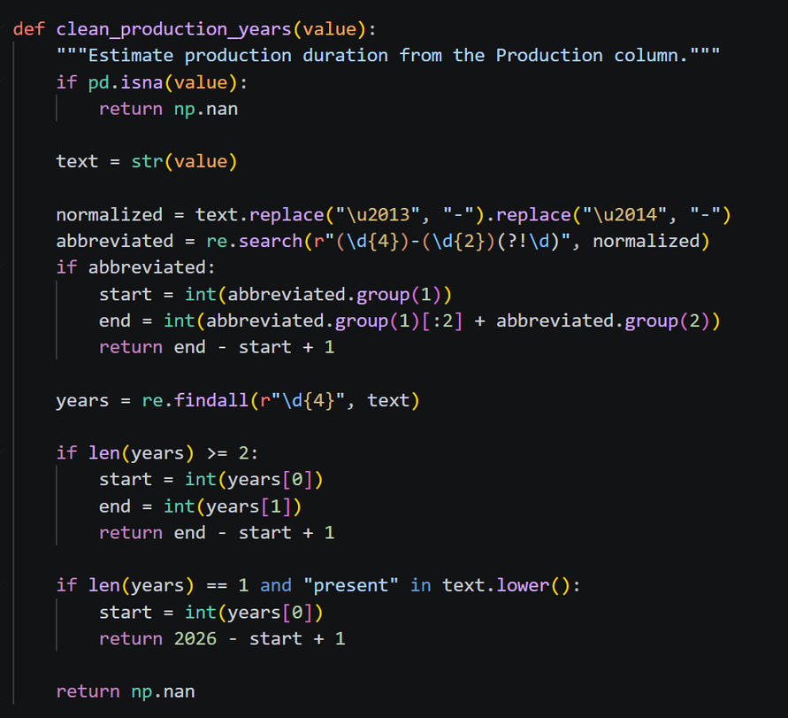
Clean production year function
Extracts production duration from text
Handles missing values
Standardizes dash formats
Supports multiple year formats such as 1990–2000 and 1990–05
Handles “present” cases dynamically
Returns production duration in years
Notes:
This function calculates how long a car model has been in production
First, it checks if the value is missing. If so, it returns NaN to avoid errors.
Wikipedia uses different dash symbols like en-dash and em-dash, so I standardize them into a regular dash for consistent processing.
Some entries use shortened year formats, like 1990 to 05. I reconstruct the full year by combining the century from the start year
Next, I extract all 4-digit years. If there are at least two, I calculate the production duration as the difference between start and end year
If the car is still in production, I calculate duration using the current year, which I set as 2026.
If none of these patterns match, the function returns NaN.

Slide 6
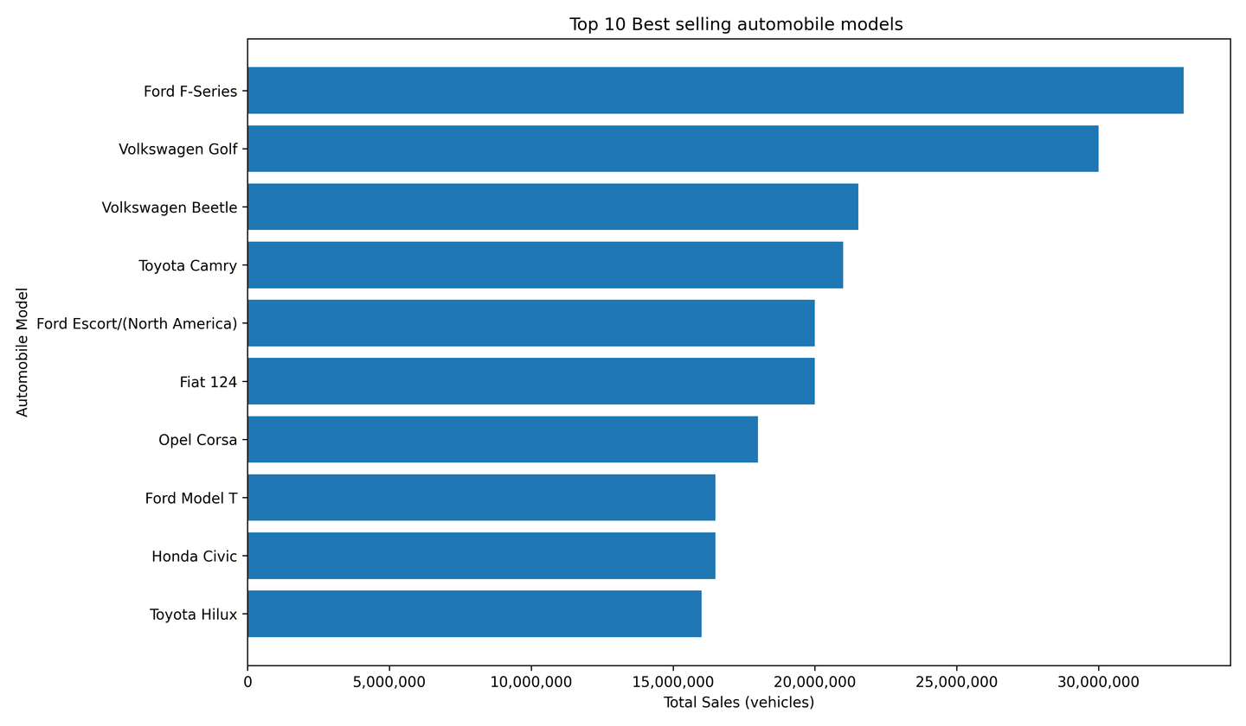
Top 10 Best selling automobile models
Highlights
Shows top 10 car models by total sales
Ford F-Series is the highest-selling model
Strong presence of Toyota, Volkswagen, and Ford
Mix of trucks, sedans, and compact cars
Sales range from ~16M to ~33M units
Notes:
This chart shows the top 10 best-selling automobile models based on total global sales.
The Ford F-Series leads by a significant margin, with over 30 million units sold, making it the most successful model in this dataset
We can see that brands like Ford, Toyota, and Volkswagen dominate the list, indicating strong global market presence and long-term success.
The list includes a mix of vehicle types, including trucks like the Ford F-Series, sedans like the Toyota Camry, and compact cars like the Volkswagen Golf
Even within the top 10, there is a noticeable range in sales, from around 16 million to over 30 million vehicles, showing varying levels of success among top models
Many of these models have been in production for decades, which likely contributes to their high cumulative sales

Slide 7
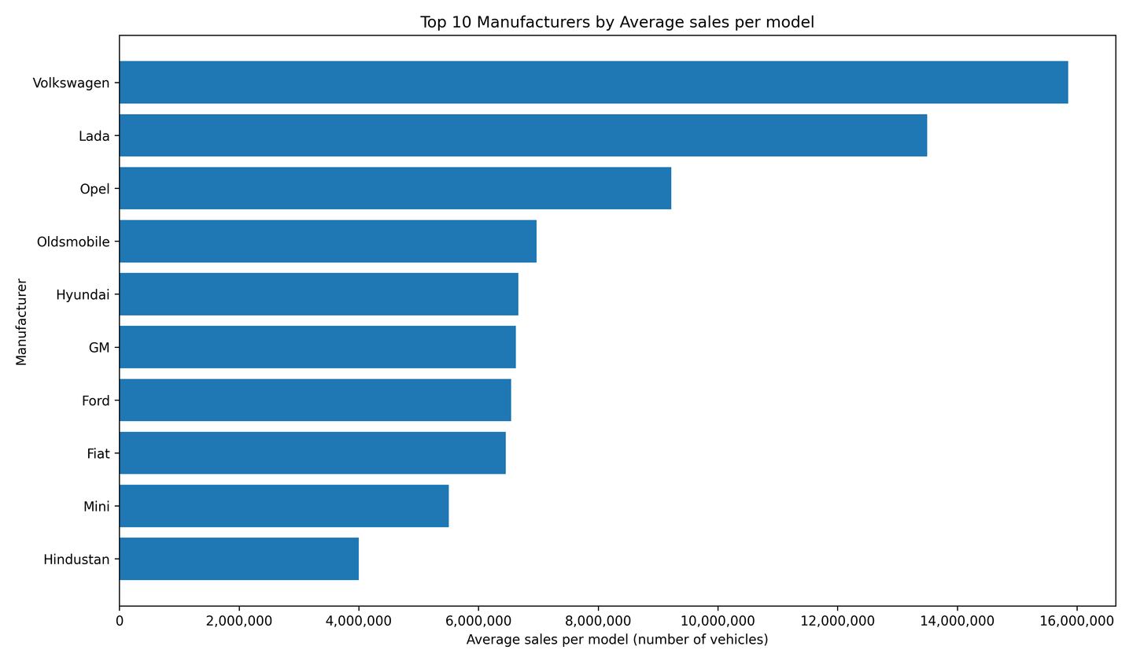
Top 10 Manufacturers by Average sales per model
Compares manufacturers by average sales per model
Volkswagen ranks highest
Lada and Opel also perform strongly
Mix of global brands represented
Highlights efficiency, not total volume
Notes:
This chart shows the top 10 manufacturers ranked by average sales per model, rather than total sales
Volkswagen ranks the highest, meaning its individual car models tend to achieve very high sales on average.
Lada and Opel also rank highly, which suggests that even with fewer global models, they have very successful individual vehicles
This is different from total sales because it focuses on how well each model performs, not how many models a company produces
Major manufacturers like Ford, GM, and Hyundai appear in the middle range, indicating consistent but not dominant average performance per model

Slide 8
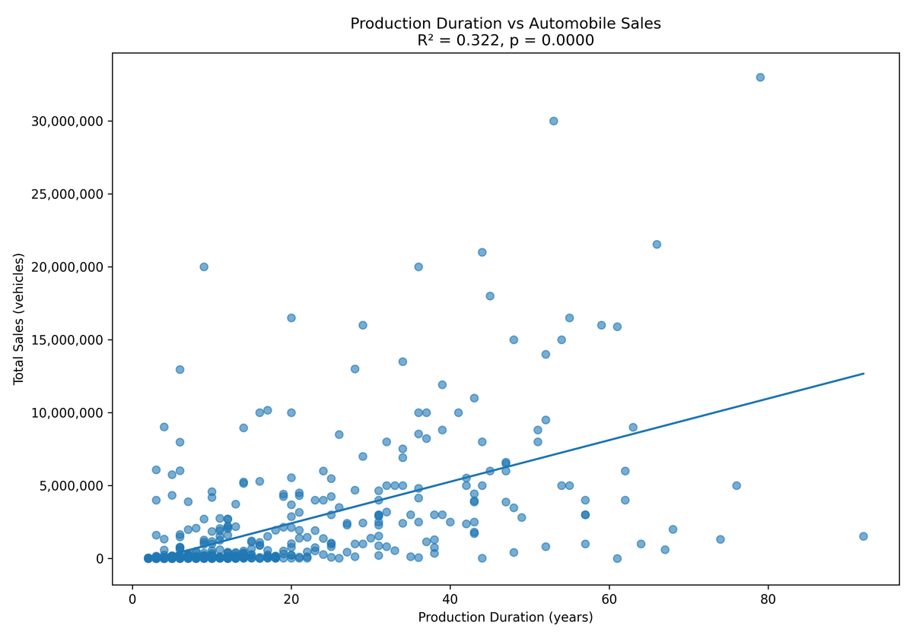
Production Duration vs Automobile Sales
Scatter plot with regression line
Positive relationship between duration and sales
R² = 0.322 indicating moderate correlation
p-value ≈ 0.0000 means statistically significant
High variability across models
Notes:
This scatter plot shows the relationship between how long a car model is produced and its total sales.
We can see a positive trend, meaning that cars produced for longer periods tend to have higher total sales
The R-squared value is about 0.322, which means production duration explains roughly 32% of the variation in sales
The p-value is essentially zero, indicating that this relationship is statistically significant and not due to random chance
However, there is a lot of spread in the data, especially for longer production durations. Some cars perform extremely well, while others do not.
This tells us that while longevity contributes to higher sales, it is not the only factor—things like brand strength, design, and market demand also play major roles.

Slide 9
Thank You

